Slide 1
Enhancing Application Delivery with KubeVela: Introducing the new cuex feature
Fog Dong @ BentoML

Slide 2
Introduction to KubeVela

Slide 3
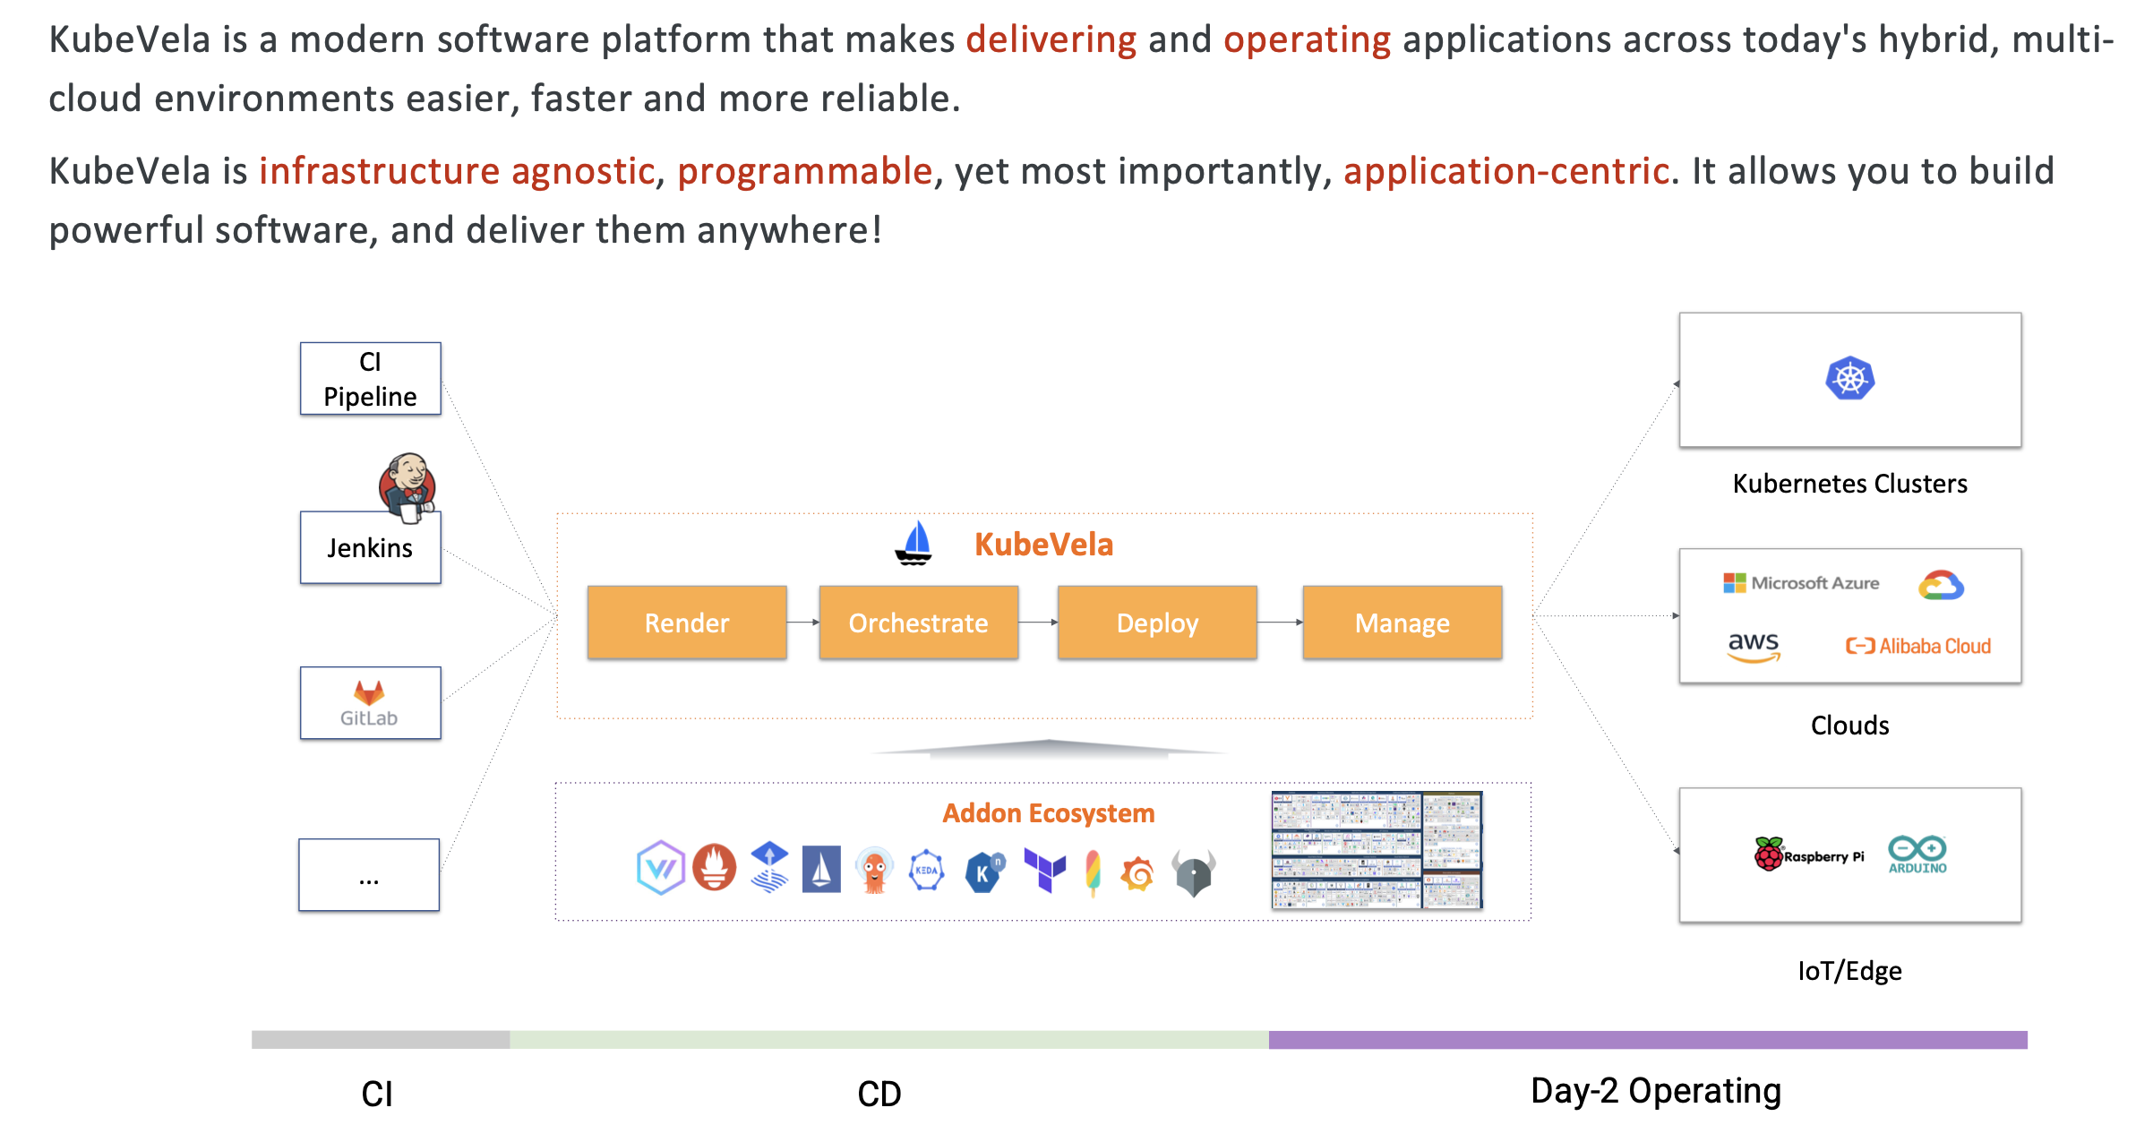
What is KubeVela

Slide 4
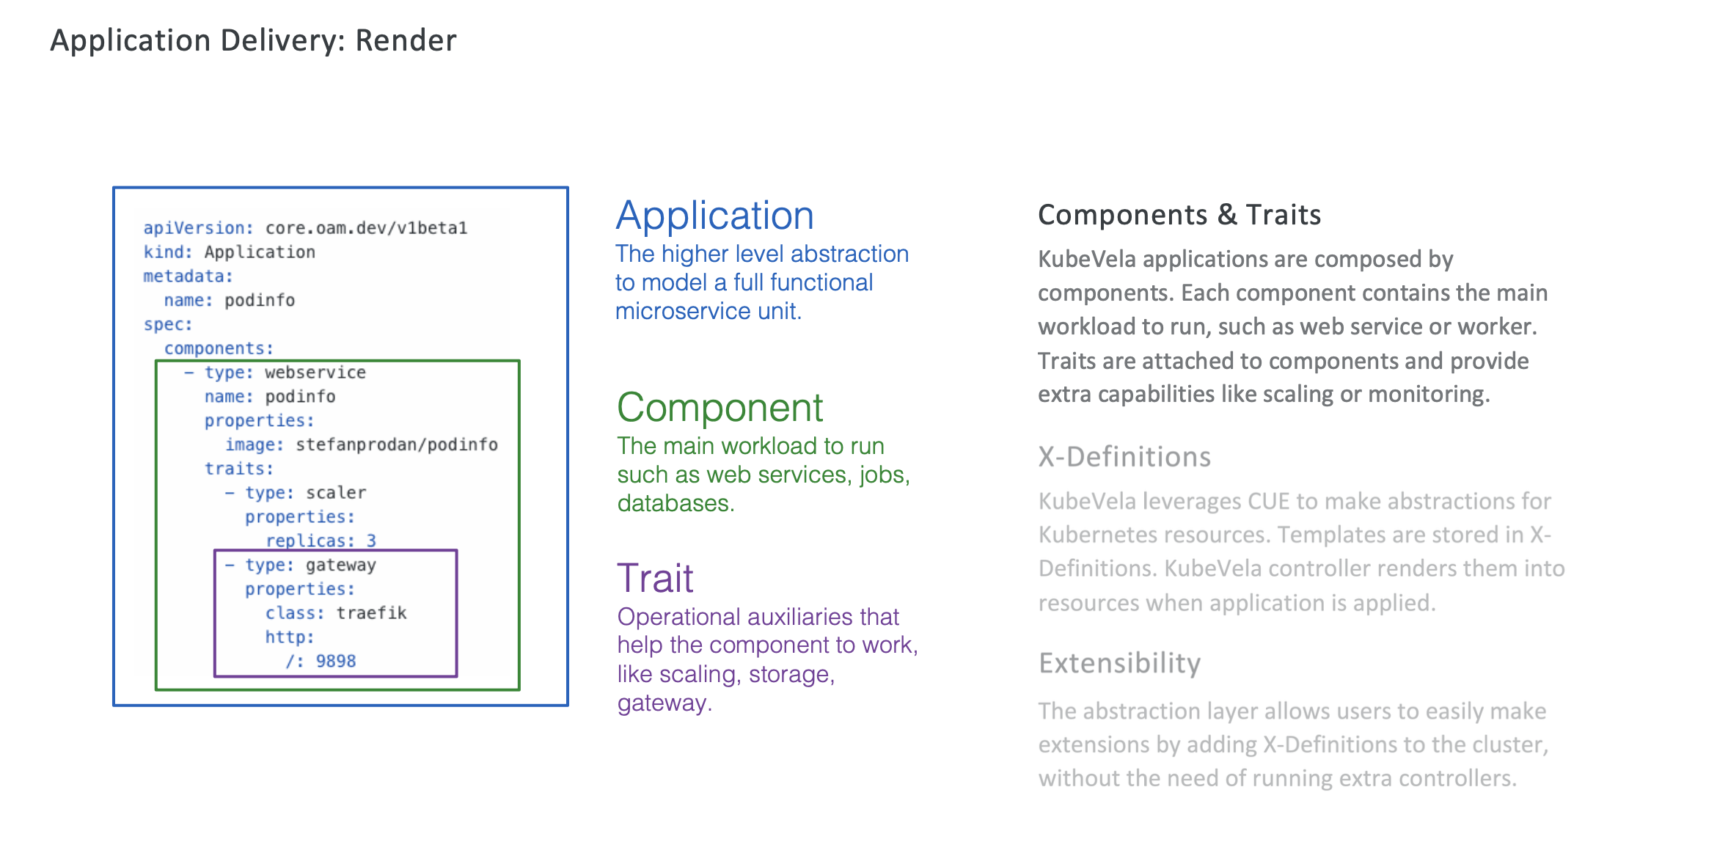
Designs & Principles

Slide 5
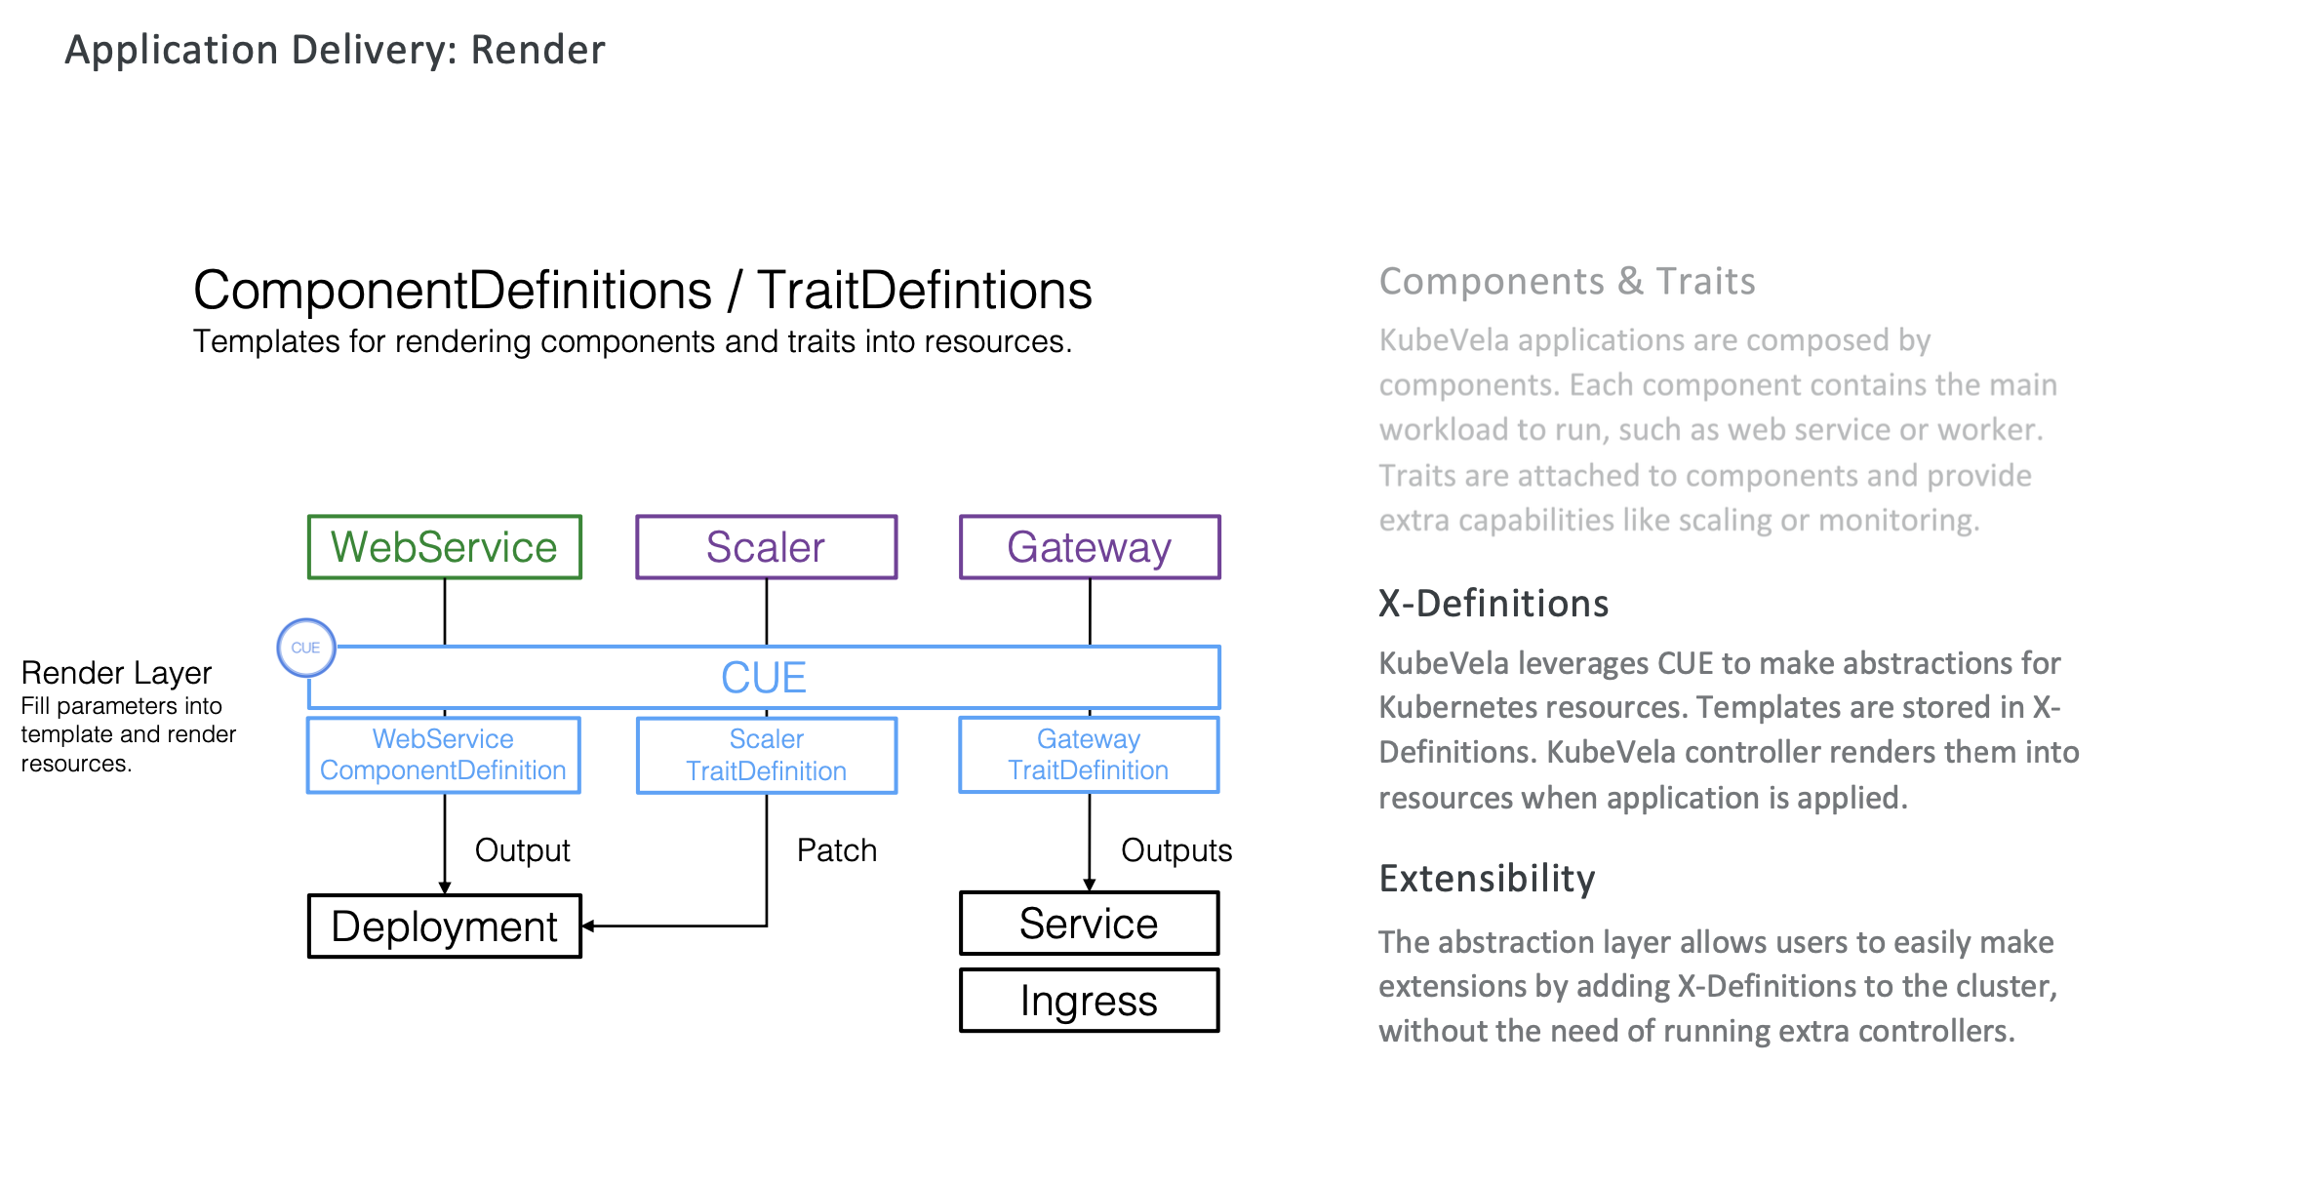
Designs & Principles

Slide 6
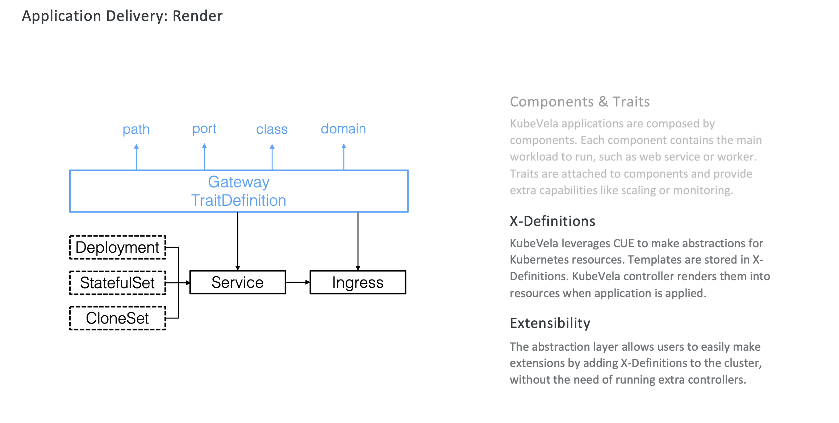
Designs & Principles

Slide 7
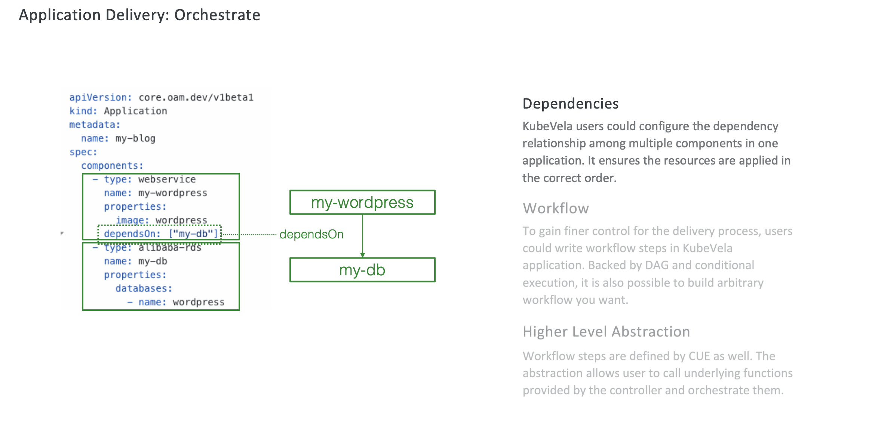
Designs & Principles

Slide 8
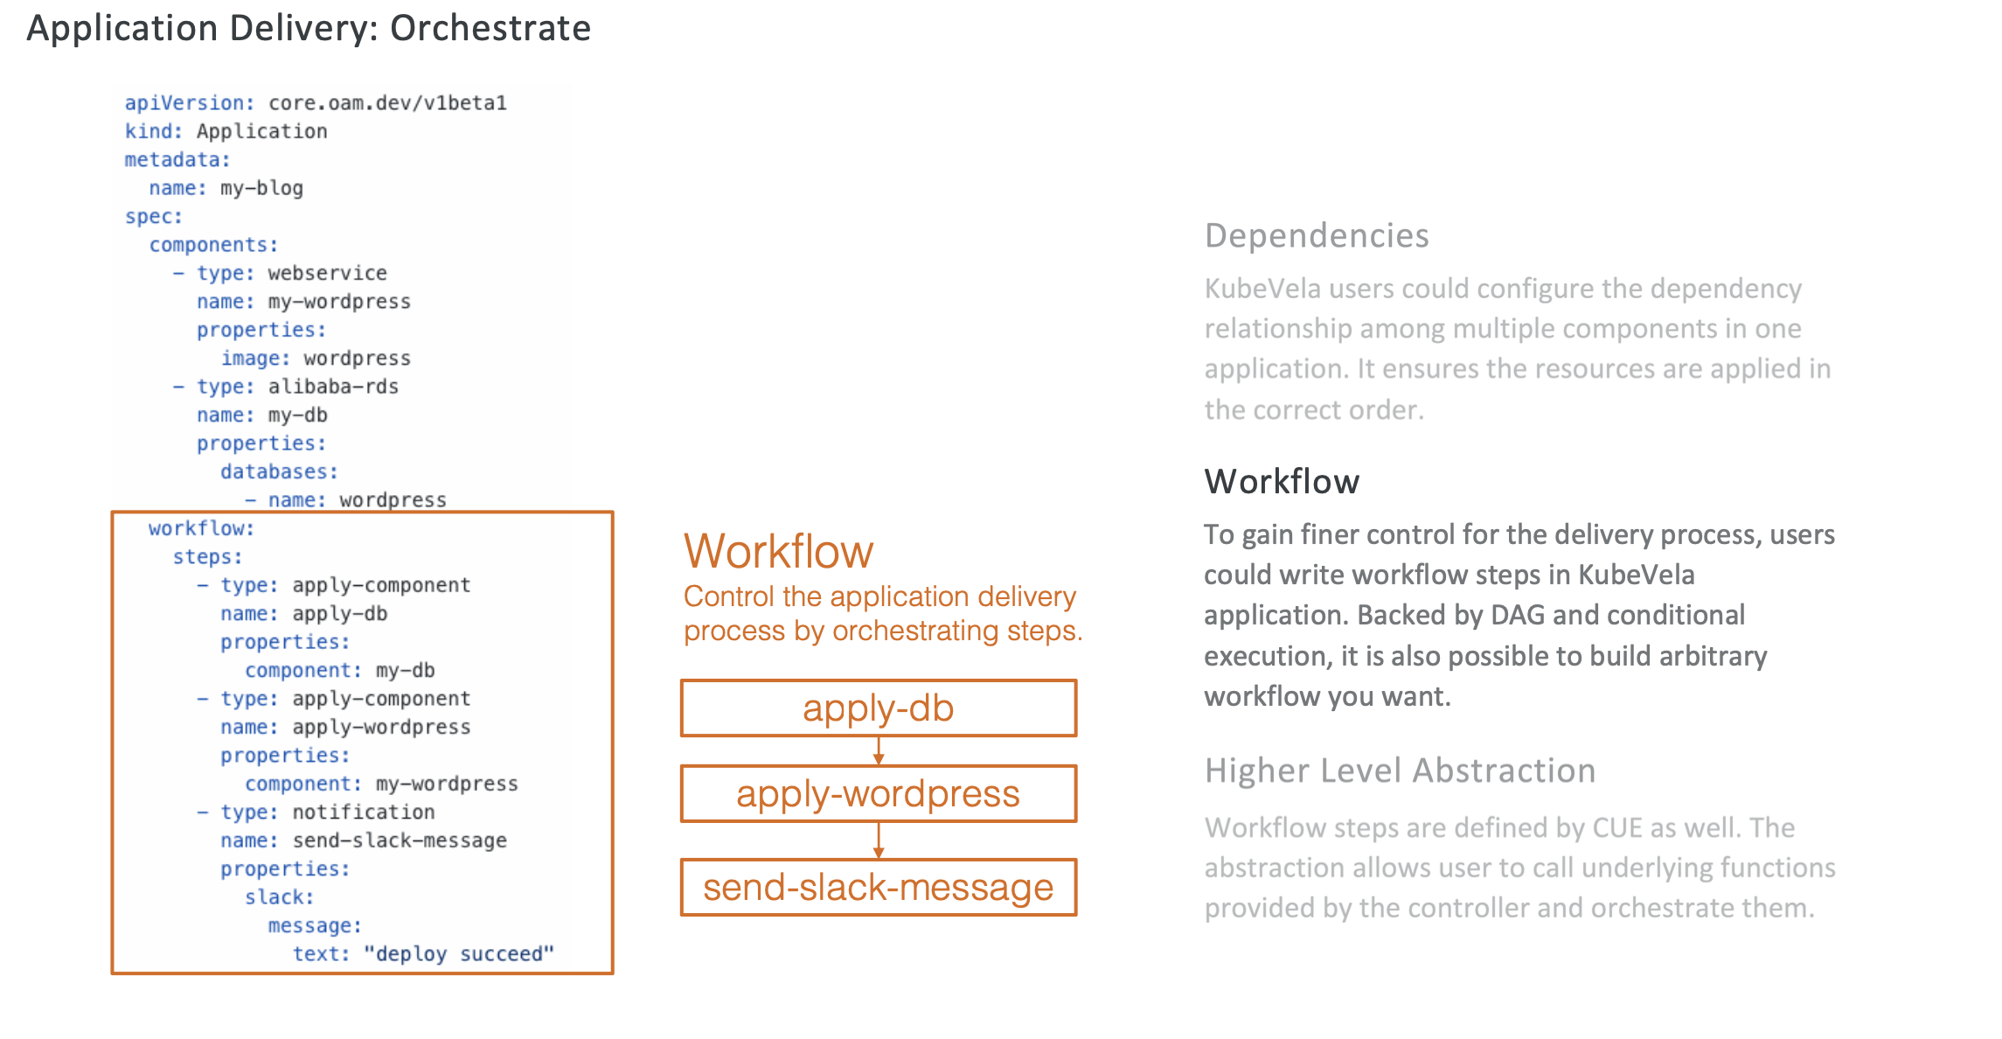
Designs & Principles

Slide 9
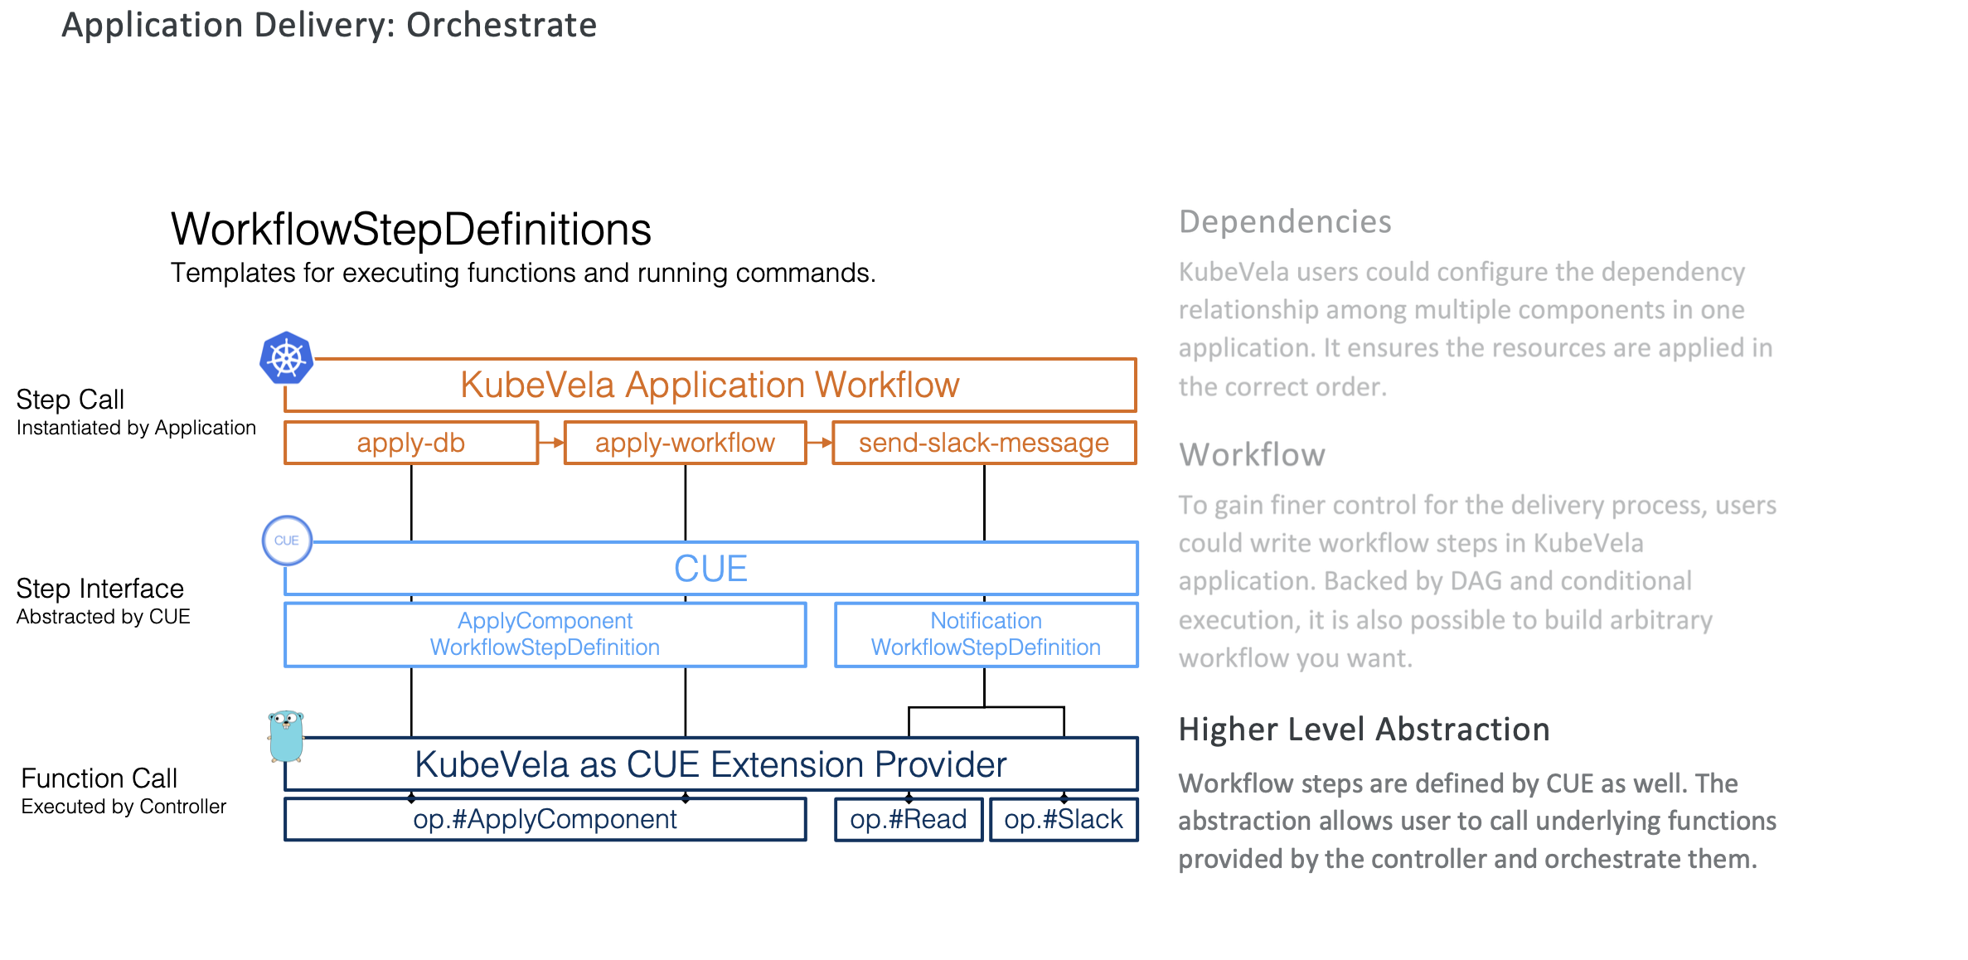
Designs & Principles

Slide 10
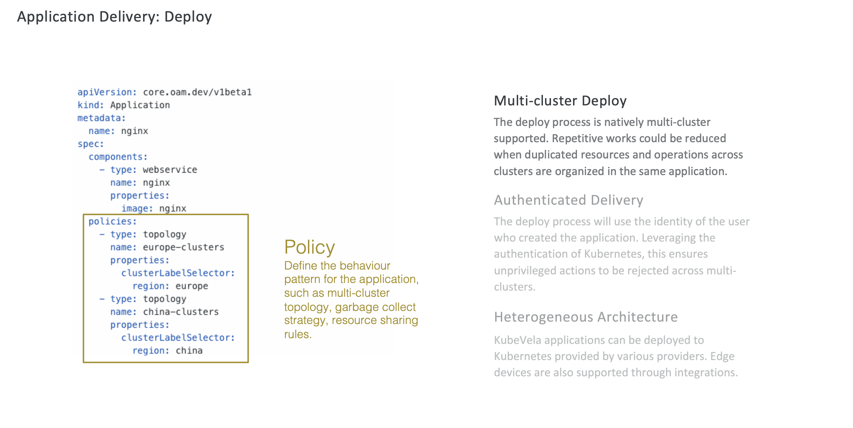
Designs & Principles

Slide 11
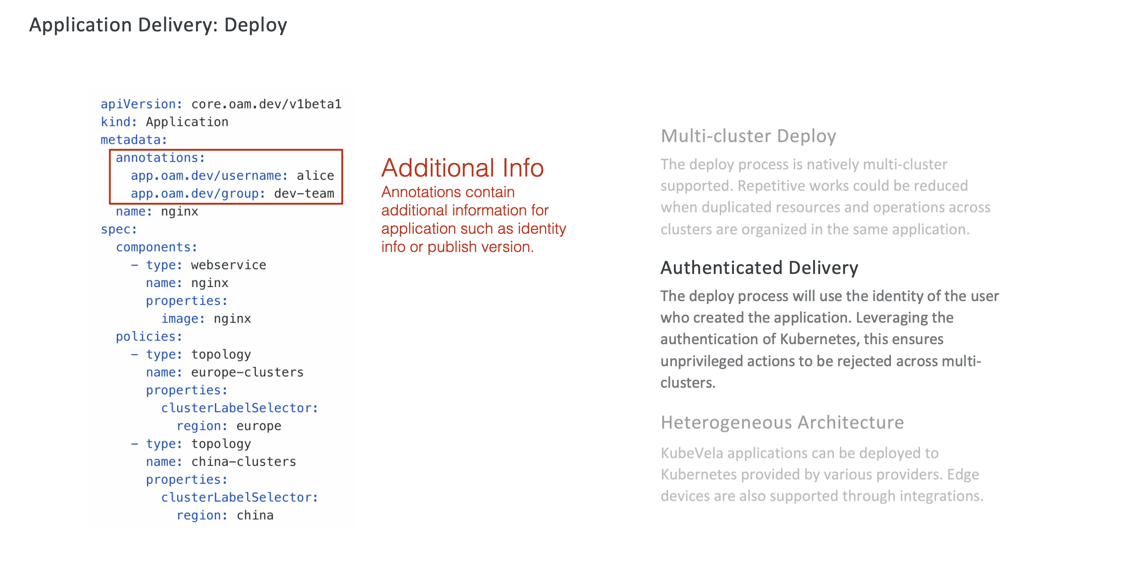
Designs & Principles

Slide 12
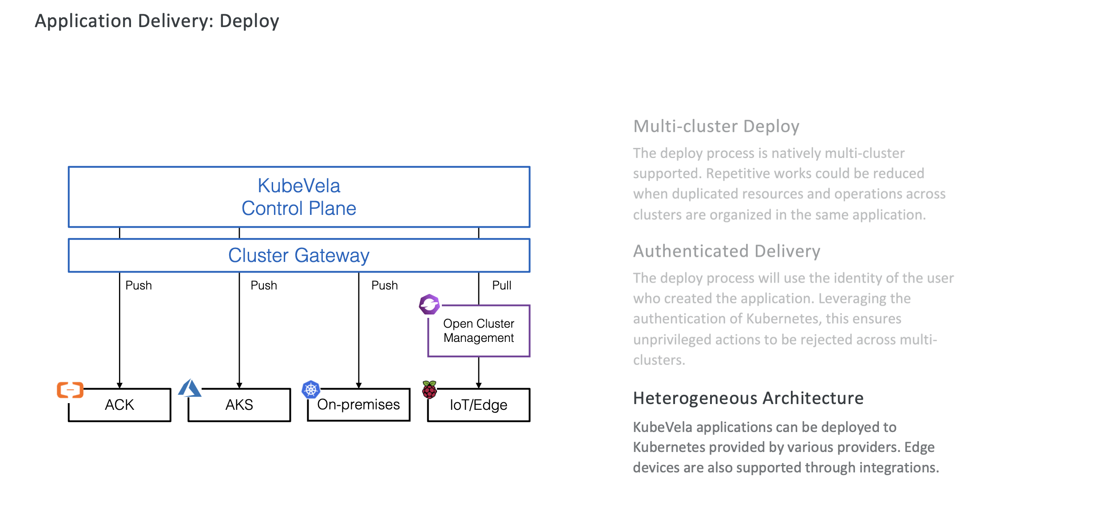
Designs & Principles

Slide 13
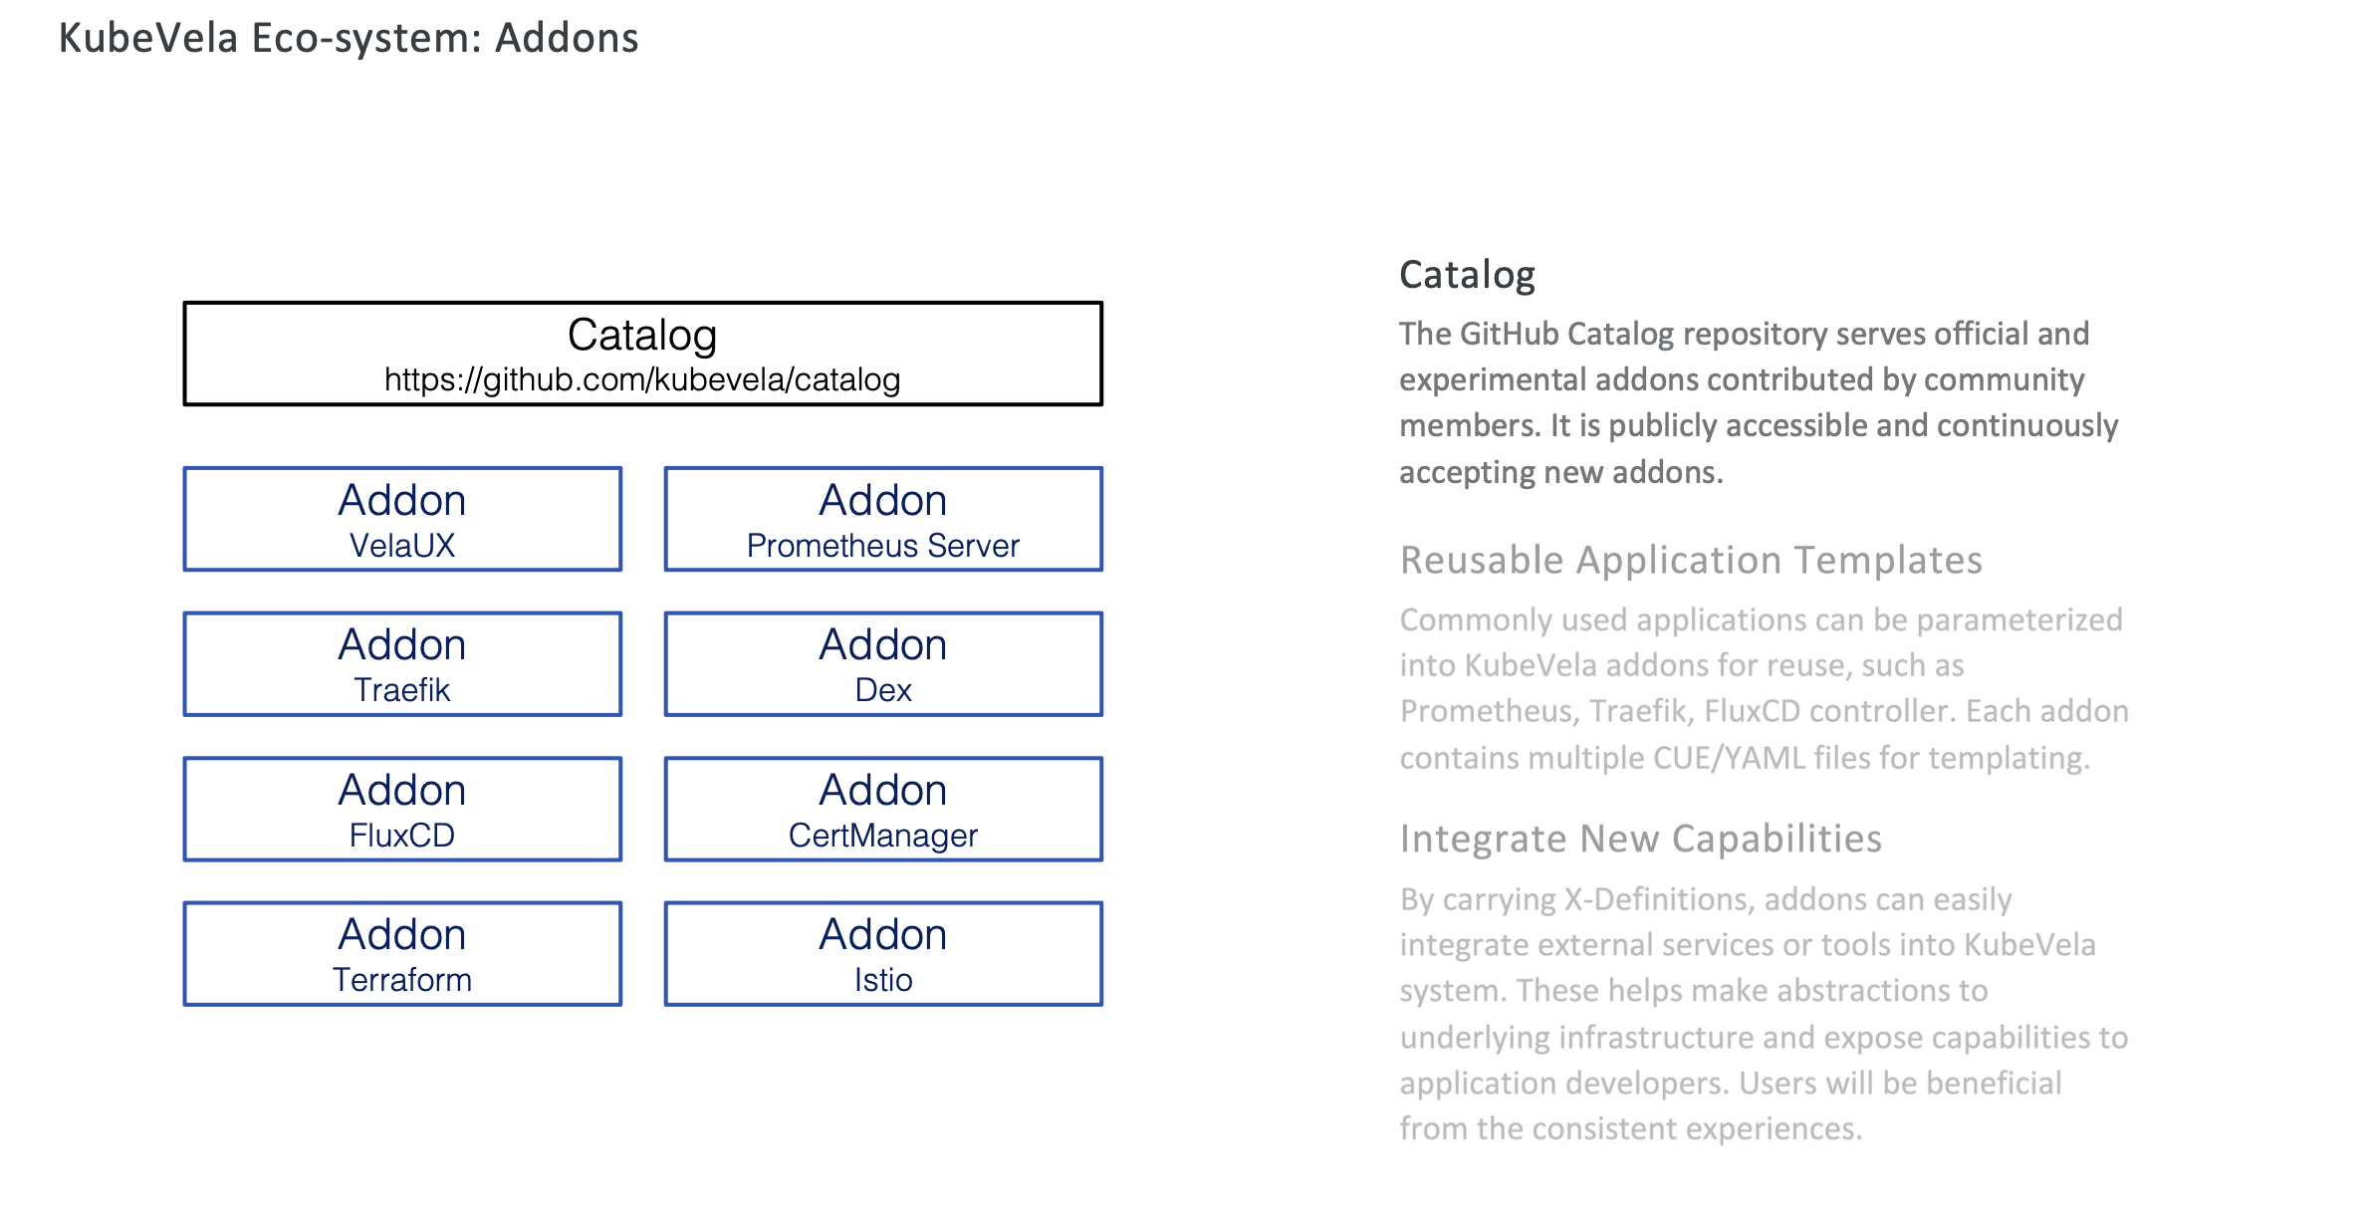
Designs & Principles

Slide 14
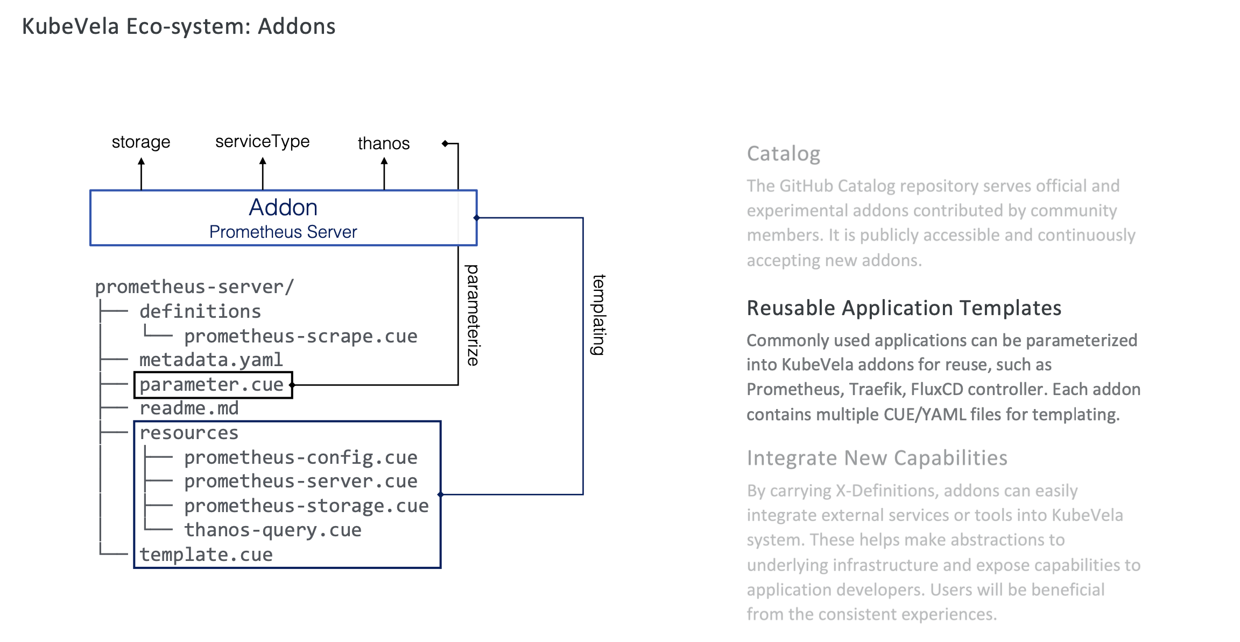
Designs & Principles

Slide 15
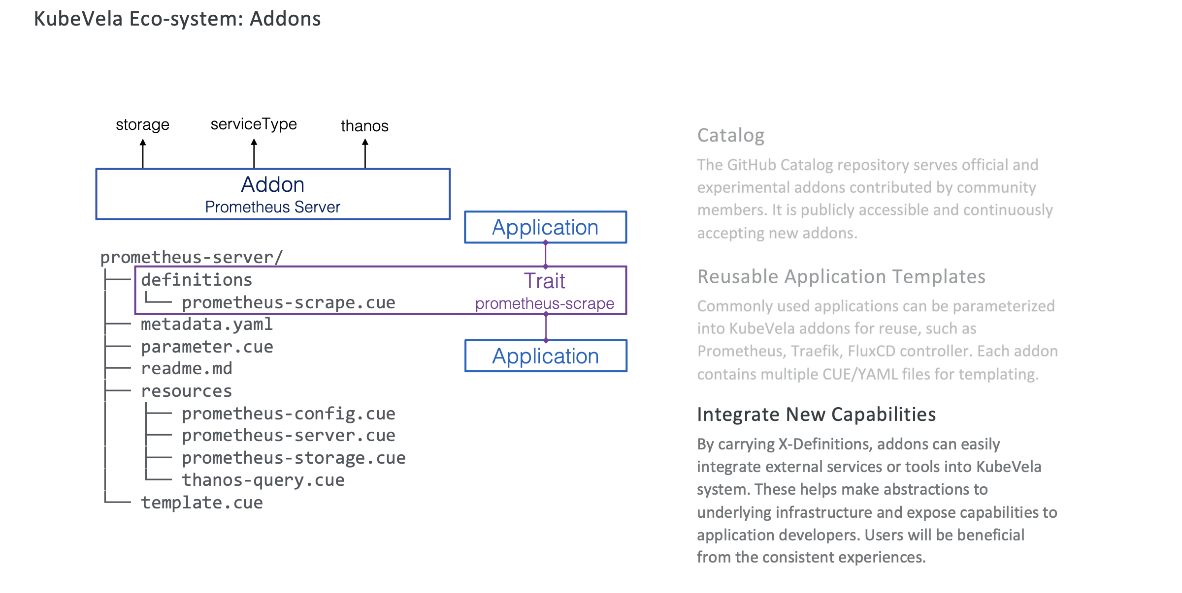
Designs & Principles

Slide 16
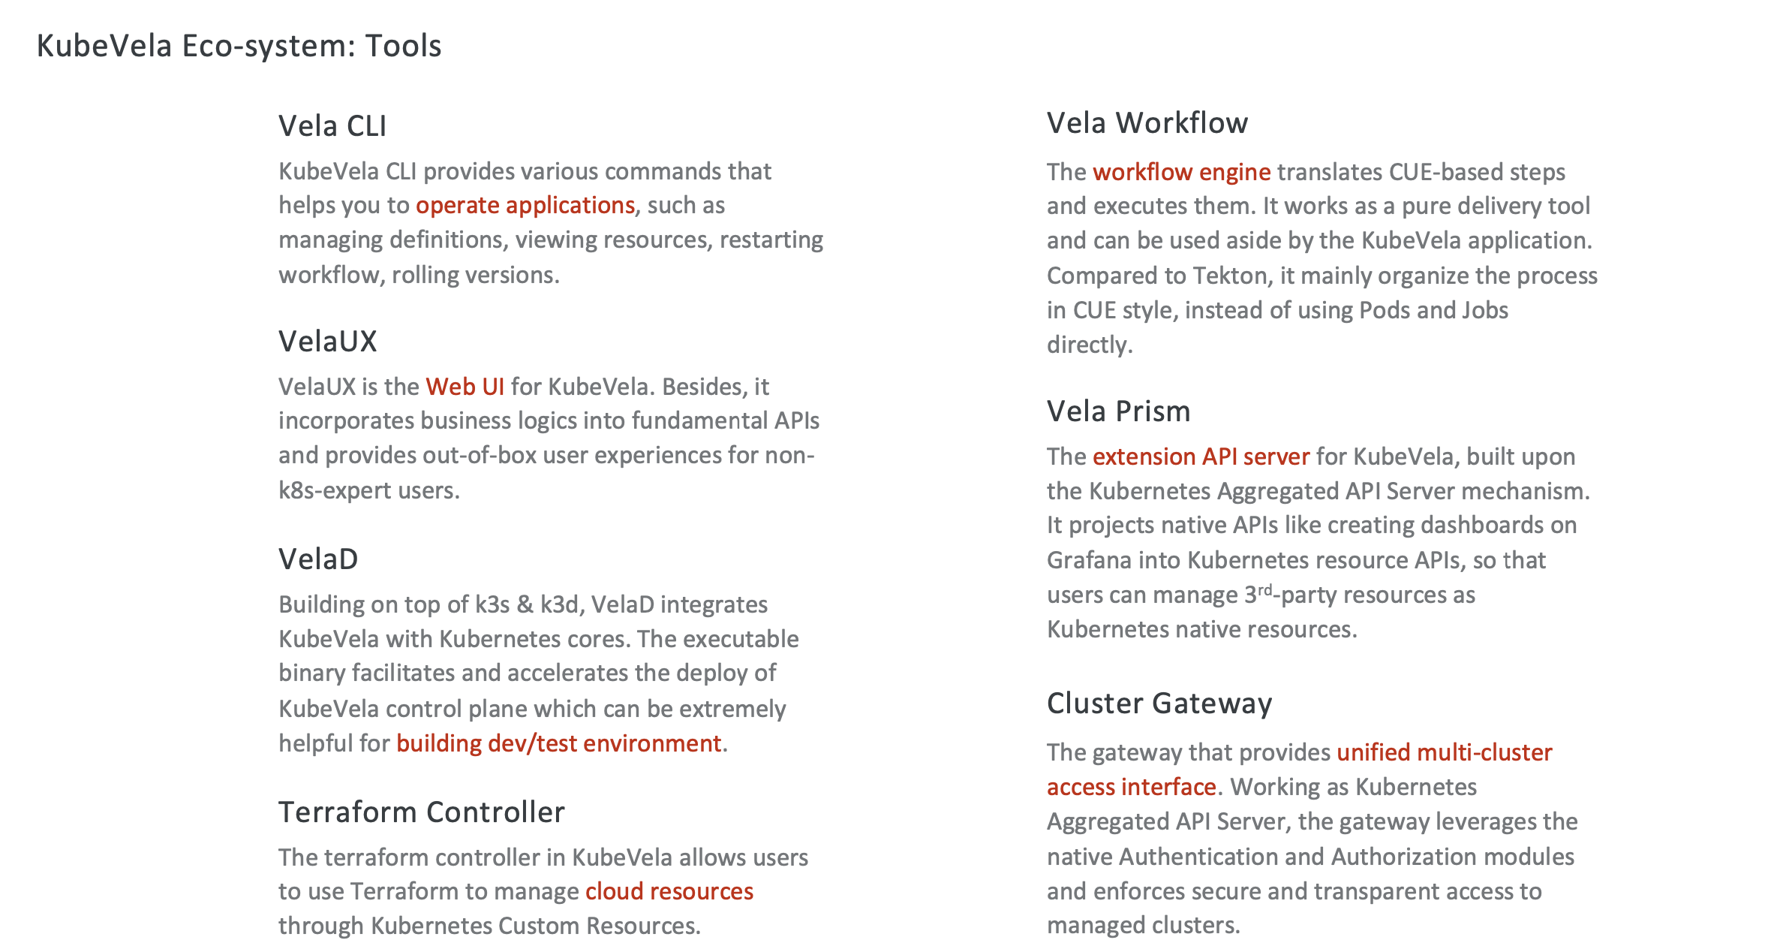
Designs & Principles

Slide 17
Introducing CueX

Slide 18
New Feature: CueX
Why we need to use CueX to refactor?
The old way:
Mix of params & returns values
Will override the existed value
Hard to understand & maintain
No modules, all in one package `op`
Can only use kubevela builtin providers
….

Slide 19
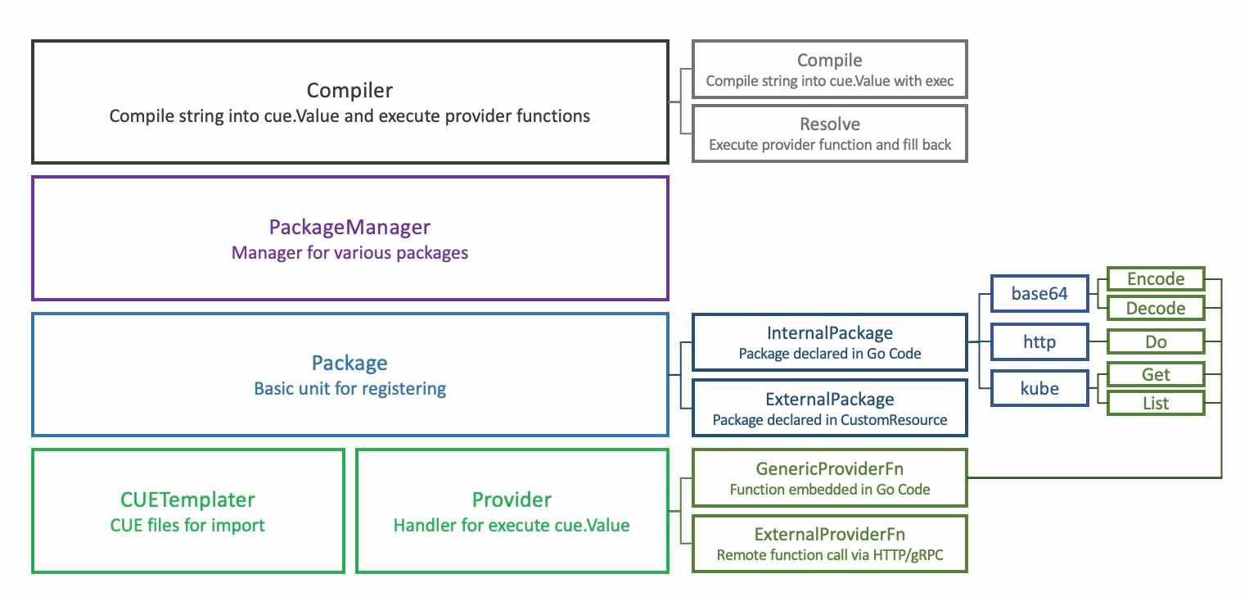
New Feature: CueX
How it works

Slide 20
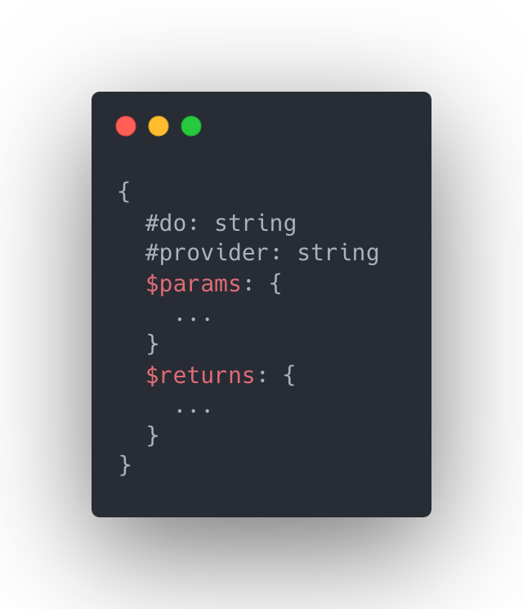
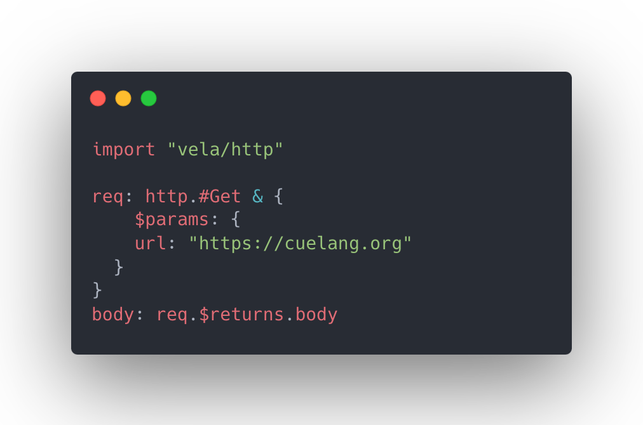
New Feature: CueX
Package Templates
Usage

Slide 21
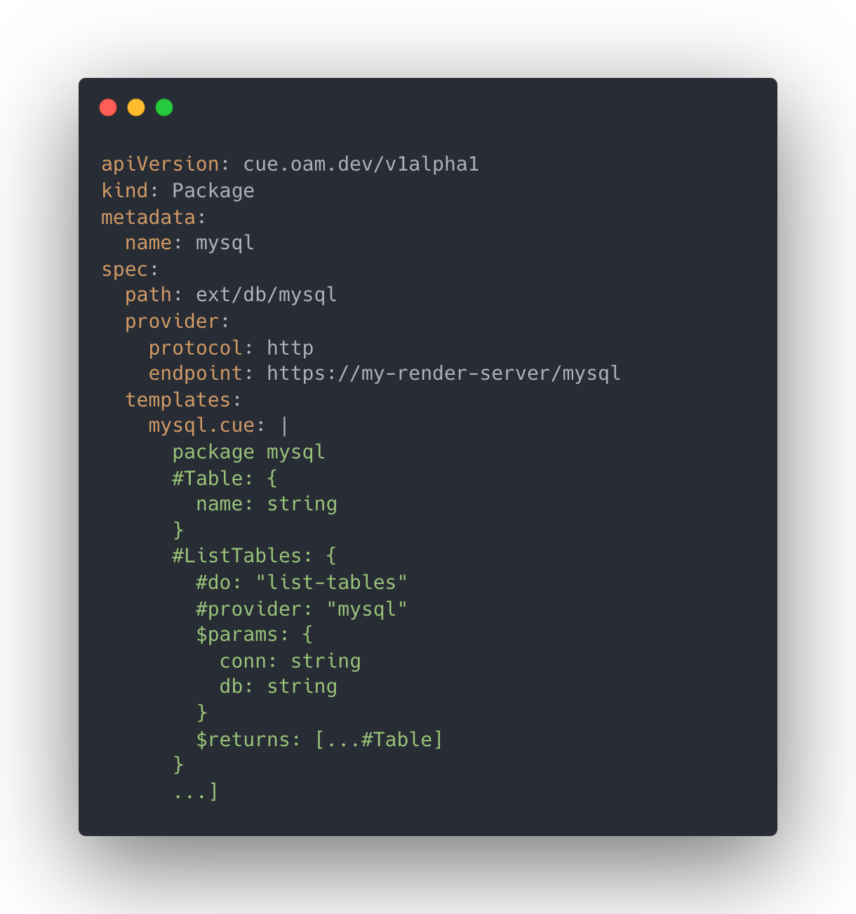
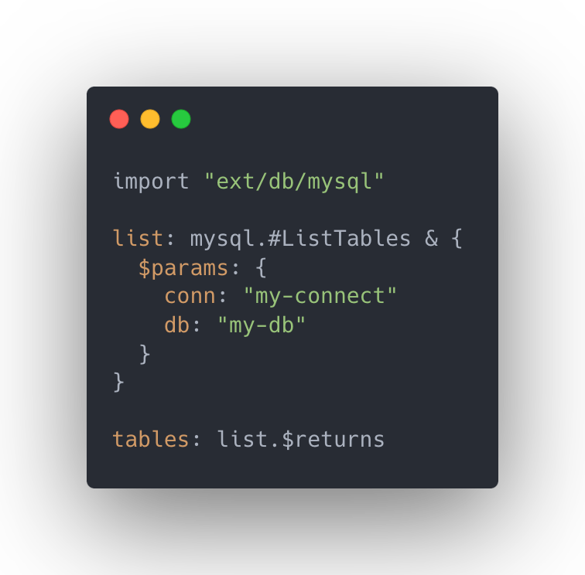
New Feature: CueX
External Packages:
Register your own!

Slide 22
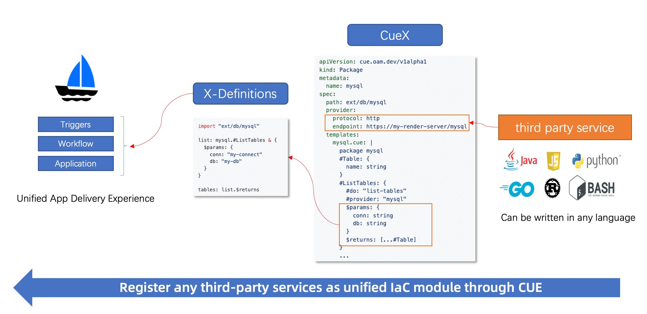
New Feature: CueX

Slide 23

Thanks!
Give us a Star!
Fog Dong @ BentoML

